Slide 1
Weekly Report
11/14/22
Erin Ingram & Omar Mahmood
NanoBio Systems Lab
Texas A&M University

Slide 2
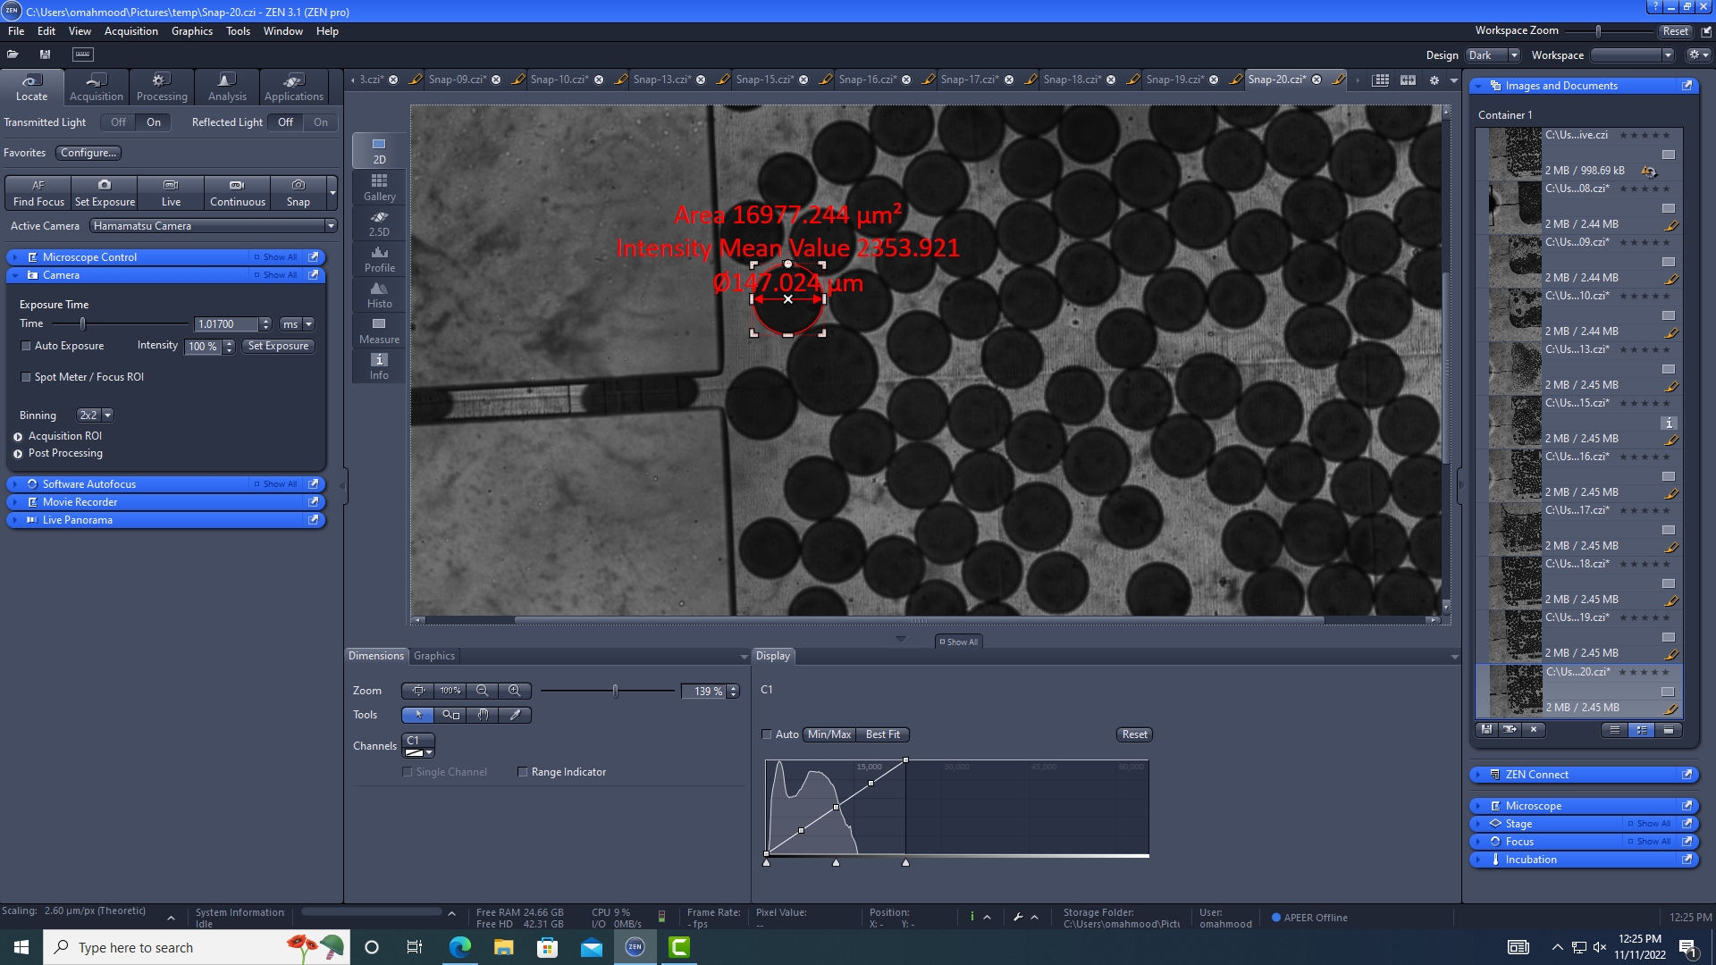
Progress
Fabricated more PDMS copies of high pass filter
Bonded PDMS to IDE
Found fault in high pass filter
Channel dimensions were printed 25 um less than specified
Began droplet generation for experimentation
150 um droplets generated

Slide 3
Goals for next week
Complete droplet generation
size 30-40 um
Correct high pass printing error
Test and validate both devices

Slide 4
Thank you for your time!

